Slide 1
Chapter 10 Motion in a Plane

Slide 2
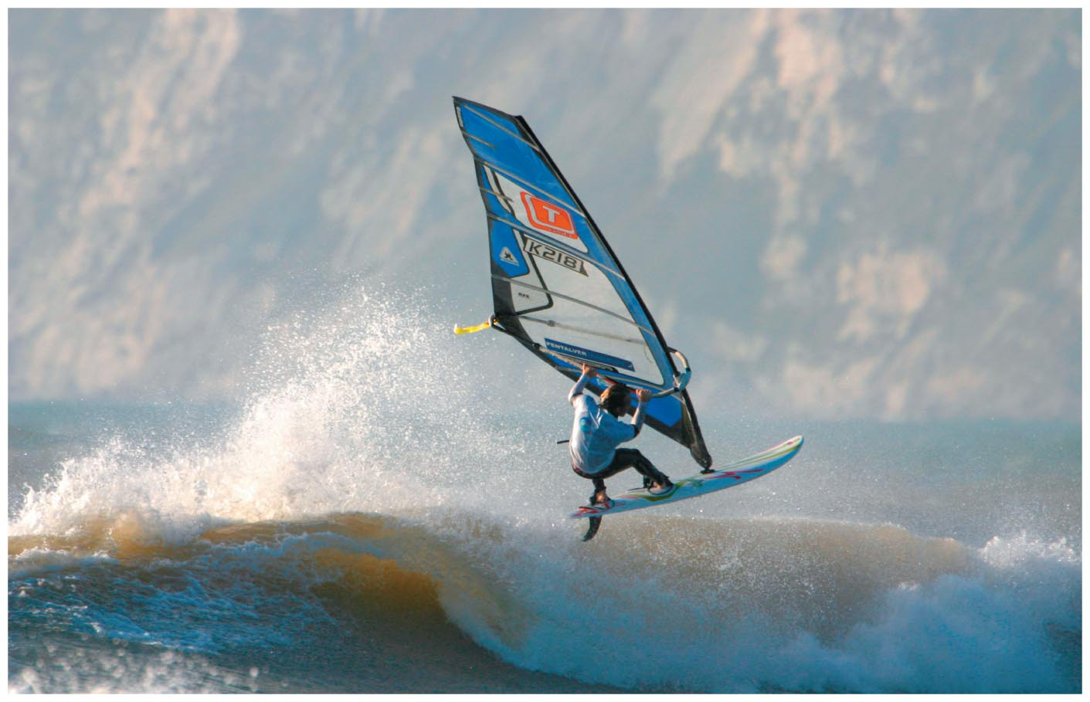
Chapter 10: Motion in a plane
Chapter Goal: Develop the tools that allow us to deal with motion that takes place in two dimensions.

Slide 3
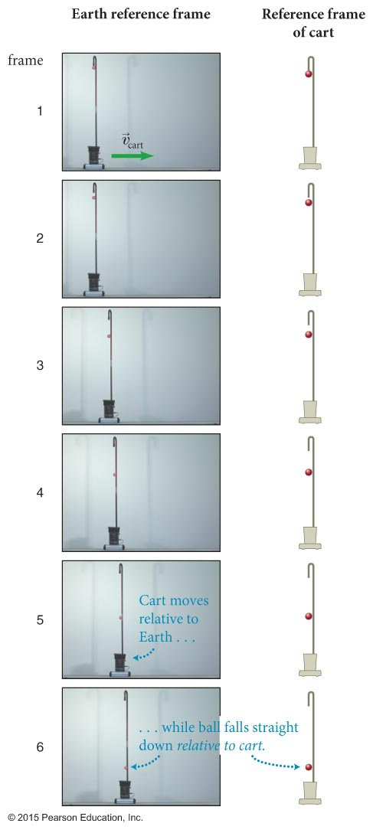
Section 10.1: Straight is a relative term
The ball is dropped from a pole attached to a cart that is moving to the right at a constant speed.
https://www.youtube.com/watch?v=mYH_nODWkqk
Skateboarding Frame of Reference Demonstration
https://www.youtube.com/watch?v=4Jc7Pe3yCW0
http://thephysicsabecedarium.com/?p=35
https://www.youtube.com/watch?v=-VJzr_aSSE4

Slide 4
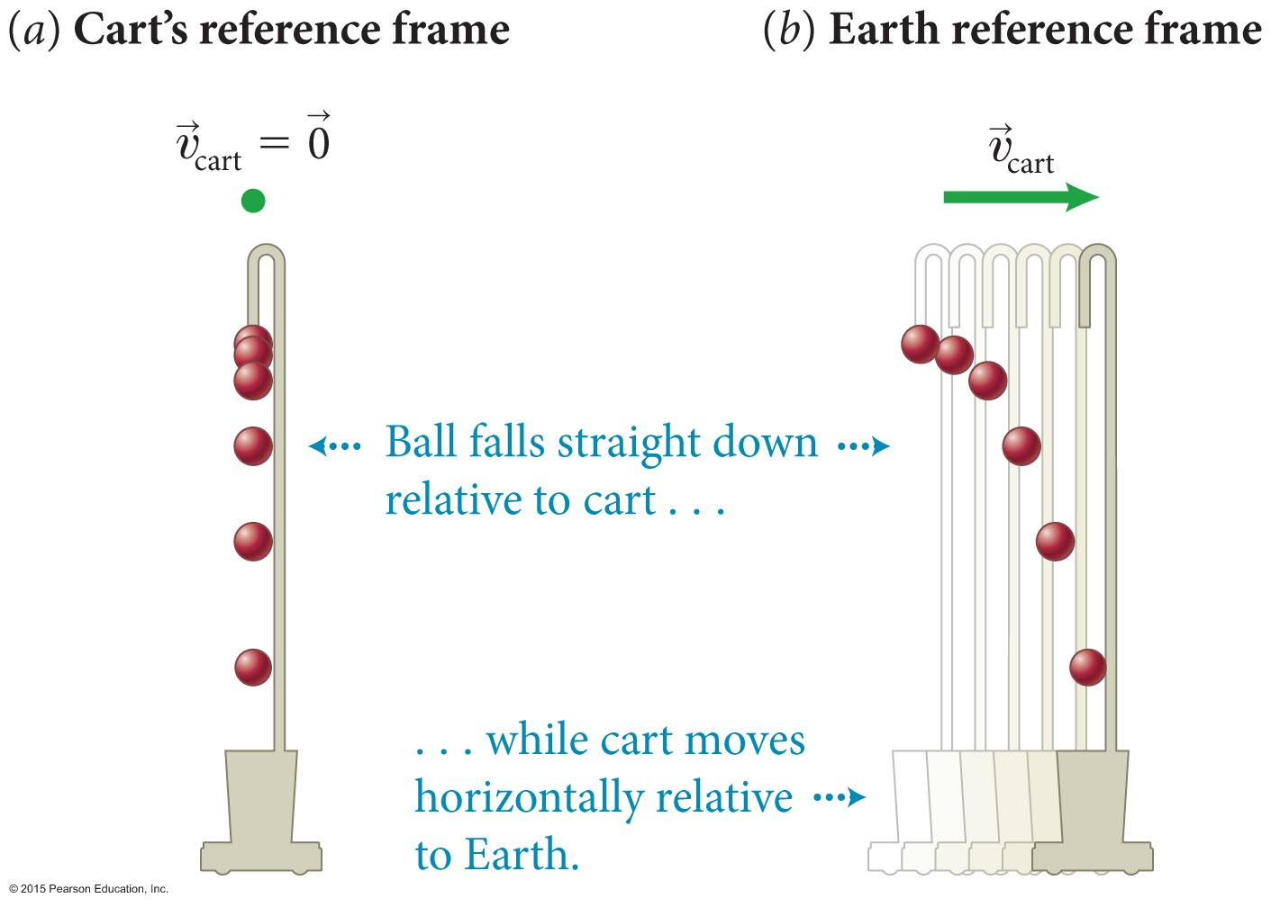
Section 10.1: Straight is a relative term
(a) The ball falls to the ground in a straight line if observed from the cart’s reference frame.
(b) The ball has a horizontal displacement in addition to the straight downward motion when observed from Earth’s reference frame.
The motion of the ball in Earth’s reference frame can be broken down into two parts:
Free fall in the vertical direction
Constant velocity motion in the horizontal direction
g
g

Slide 5
Section 10.1
Clicker Question 1
A passenger in a speeding train drops a peanut.
Which is greater?
The magnitude of the acceleration of the peanut as measured by the passenger.
The magnitude of the acceleration of the peanut as measured by a person standing next to the track.
Neither, the accelerations are the same to both observers.

Slide 6
Section 10.1
Clicker Question 1
A passenger in a speeding train drops a peanut.
Which is greater?
The magnitude of the acceleration of the peanut as measured by the passenger.
The magnitude of the acceleration of the peanut as measured by a person standing next to the track.
Neither, the accelerations are the same to both observers.

Slide 7
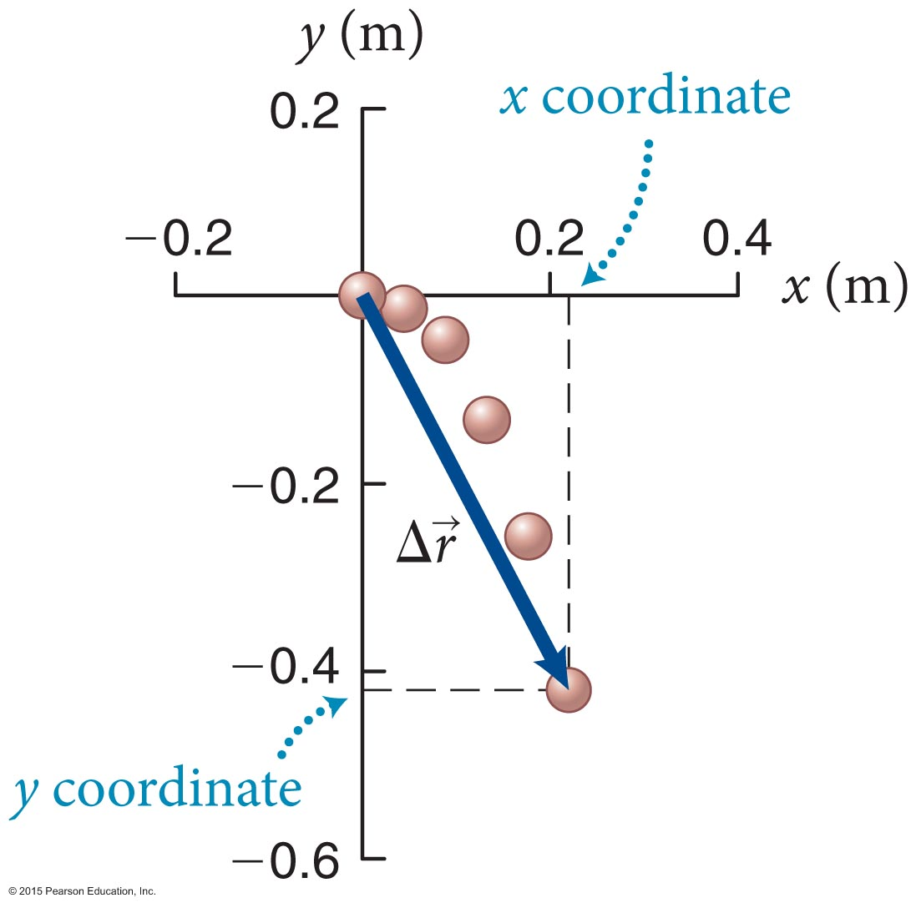
Section 10.2: Vectors in a plane
To analyze the motion of an object moving in a plane, we need to define two reference axes, x and y.
The ball’s displacement in Earth’s reference frame is the vector sum of the horizontal displacement and the vertical displacement

Slide 8
Section 10.2: Vectors in a plane
The vector sum of two vectors in a plane is obtained by placing the tail of the second vector at the head of the first vector.
To subtract a vector from a vector reverse the direction of and then add the reversed to

Slide 9
Section 10.2: Vectors in a plane
Any vector can be decomposed to component vectors and along the axes of some conveniently chosen set of mutually perpendicular axes, called a rectangular coordinate system.
The procedure for decomposing a vector is shown below.

Slide 10
Section 10.2: Vectors in a plane
The figure below shows the decomposition of a vector in three coordinate systems.
You need to choose the coordinate system that best suits the problem at hand.

Slide 11
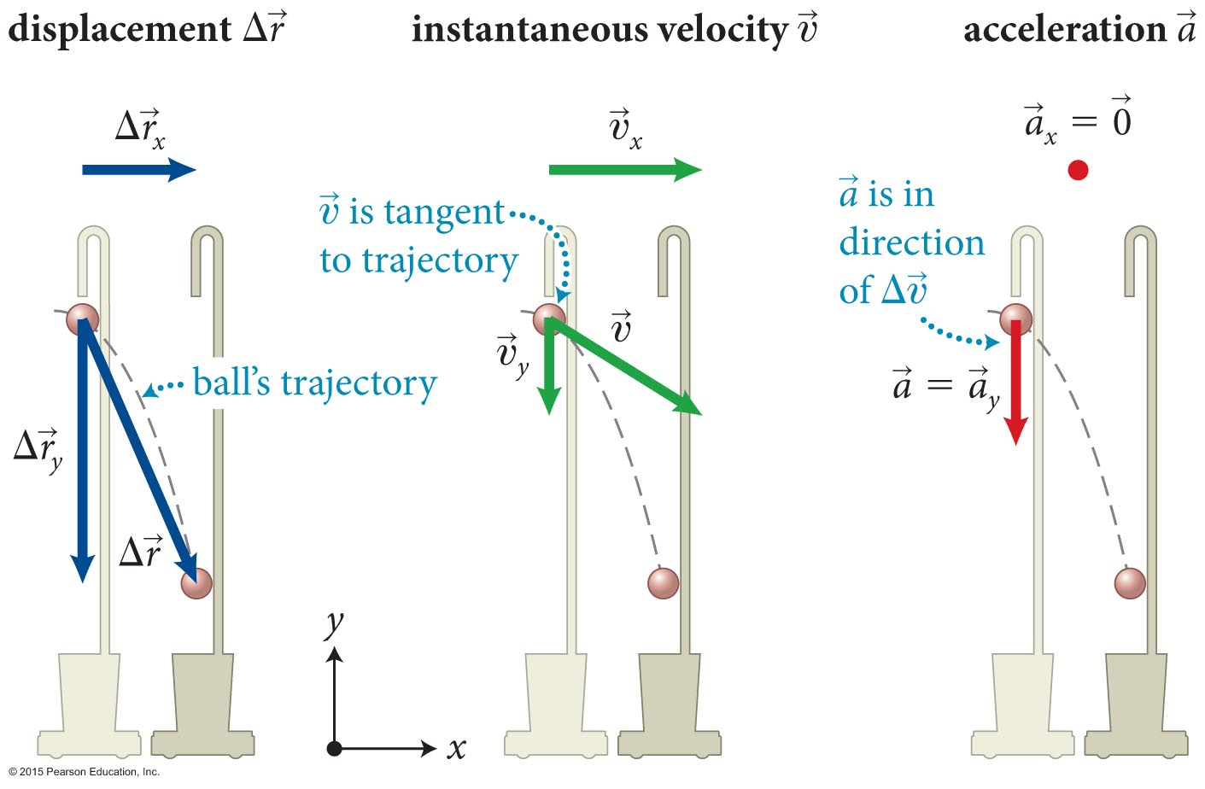
Section 10.2: Vectors in a plane
The displacement, instantaneous velocity, and acceleration of the ball in the previous section is shown below.
Notice that the instantaneous velocity and acceleration are not in the same direction. What does this mean?

Slide 12
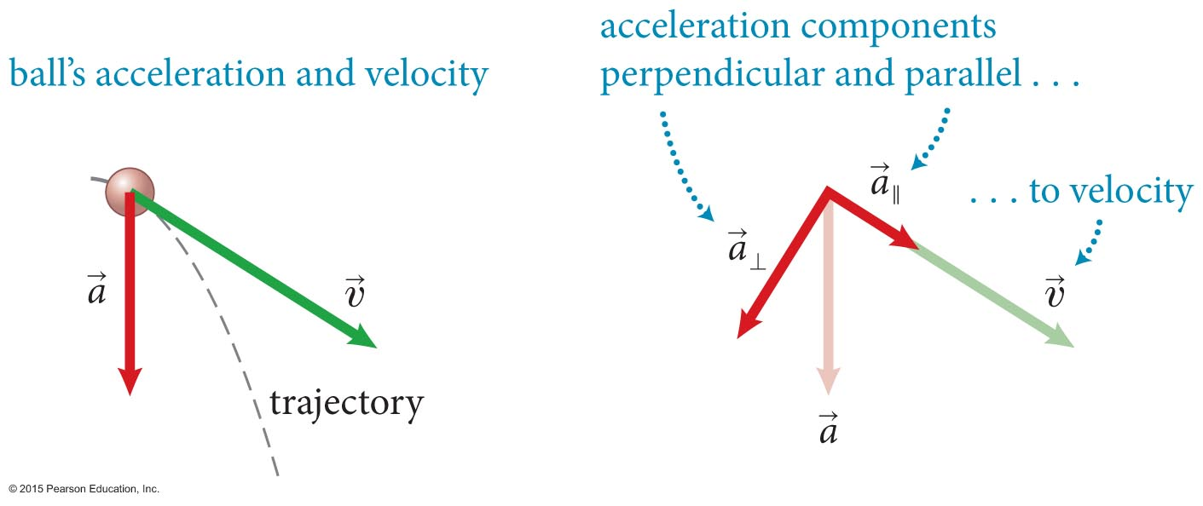
Section 10.2: Vectors in a plane
Decompose the acceleration vector into two components: one parallel to the instantaneous velocity, and one perpendicular to it.
The component of the acceleration of the ball parallel to the instantaneous velocity changes the speed; the component of acceleration perpendicular to the instantaneous velocity changes the direction of the velocity but not its magnitude.
Velocity component parallel to acceleration changes.
Velocity component perpendicular to acceleration stays unchanged.

Slide 13
Checkpoint 10.2
In Figure 10.10, the ball’s instantaneous velocity does not point in the same direction as the displacement (it points above the final position of the ball). Why?
10.2

Slide 14
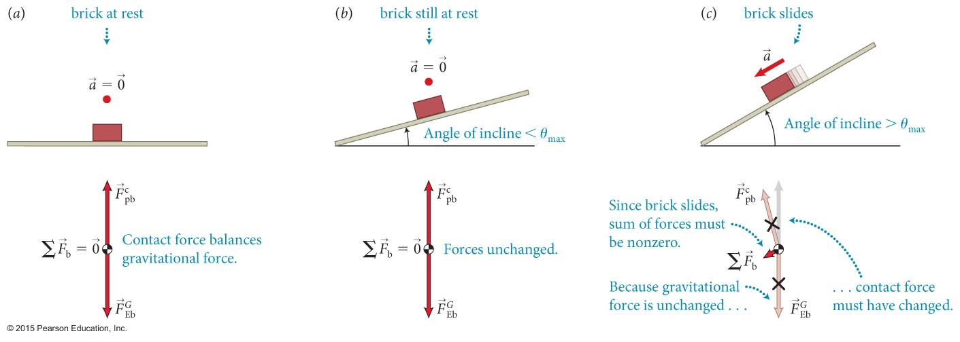
Section 10.3: Decomposition of forces
The figure shows a brick lying on a horizontal plank and then the plank is gently tilted. At first, due to friction, it remains at rest.
When the angle of incline exceeds a θ_{max} the brick accelerates down the incline.
Then, the vector sum of the forces exerted on the brick must also point down the incline.

Slide 15
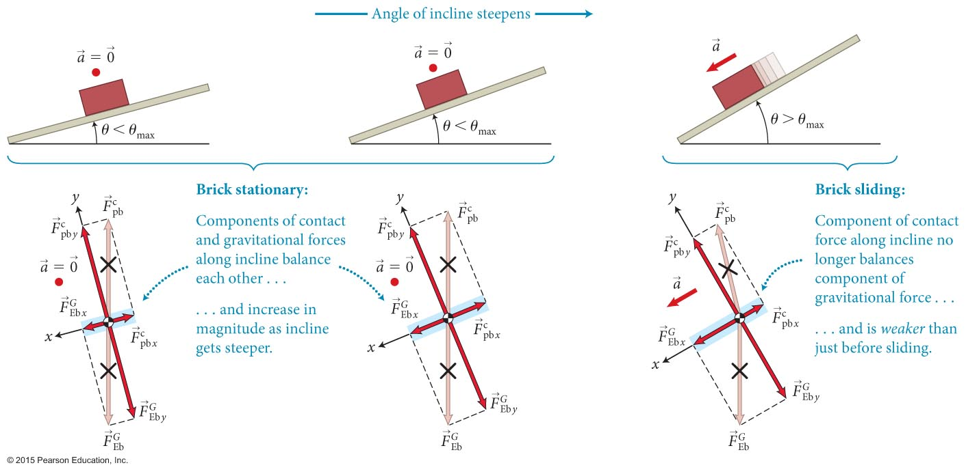
Section 10.3: Decomposition of forces
Because the brick is constrained to move along the surface of the plank, it make sense to choose the x axis along surface, as illustrated in the figure.
The force components parallel to the surface are called tangential components.
The force components perpendicular to the surface are called normal components.

Slide 16
Section 10.3: Decomposition of forces
The brick problem suggests which axes we should choose in a given problem:
If possible, choose a coordinate system such that one of the axes lies along the direction of the acceleration of the object under consideration.

Slide 17
Chapter 10 Motion in a Plane

Slide 18
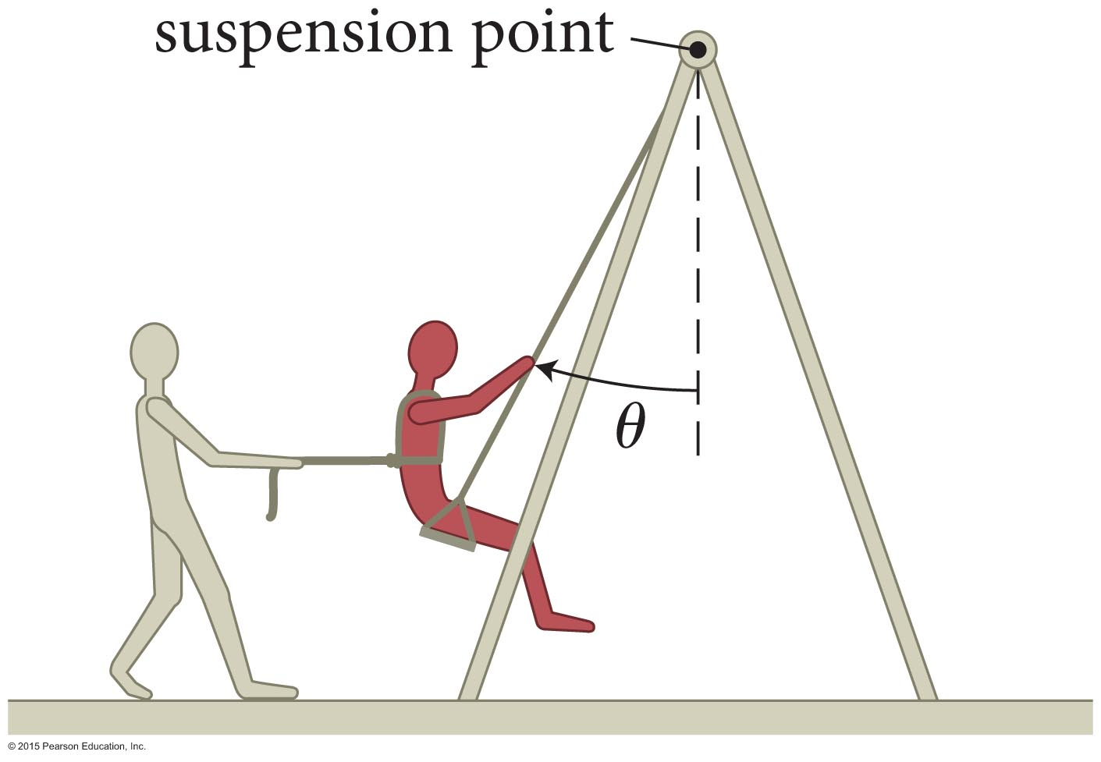
Example 10.2 Pulling a friend on a swing
Section 10.3: Decomposition of forces
Using a rope, you pull a friend sitting on a swing (Figure 10.16). (a) As you increase the angle θ, does the magnitude of the force required to hold your friend in place increase or decrease?

Slide 19
Example 10.2 Pulling a friend on a swing (cont.)
Section 10.3: Decomposition of forces
(b) Is the magnitude of larger than, equal to, or smaller than the magnitude of the gravitational force exerted by Earth on your friend? (Consider the situation for both small and large values of θ.)
Claim: There is an angle at which

Slide 20
Example 10.2 Pulling a friend on a swing (cont.)
Section 10.3: Decomposition of forces
(c) Is the magnitude of the force exerted by the swing on your friend larger than, equal to, or smaller than

Slide 21
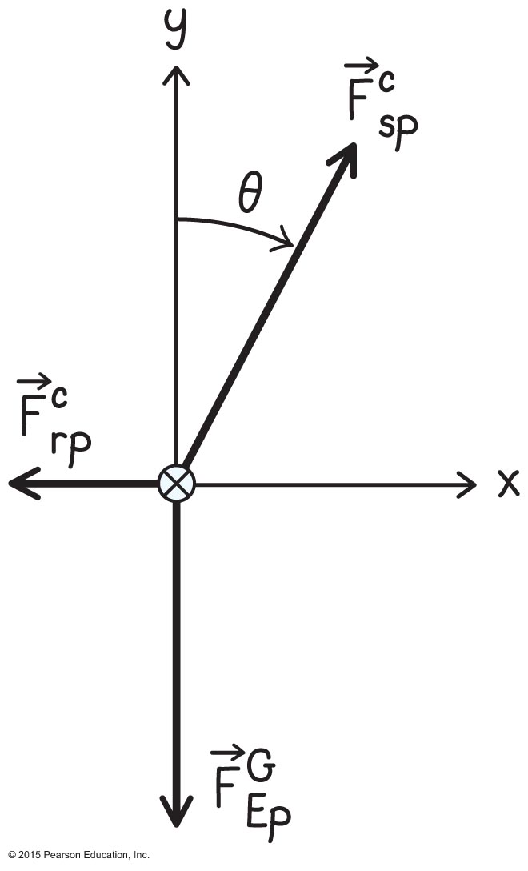
Example 10.2 Pulling a friend on a swing
Section 10.3: Decomposition of forces
❶ GETTING STARTED Begin by drawing a free-body diagram of your friend (Figure 10.17). Three forces are exerted on him: the force of gravity directed vertically downward, the horizontal force exerted by the rope, and a force exerted by the swing seat.

Slide 22
Example 10.2 Pulling a friend on a swing
Section 10.3: Decomposition of forces
❶ This latter force is exerted by the suspension point via the chains of the swing and is thus directed along the chains. Choose a horizontal x axis and a vertical y axis, so that two of the three forces lie along axes. Because your friend’s acceleration is zero, the vector sum of the forces must be zero.
θ

Slide 23
Example 10.2 Pulling a friend on a swing
Section 10.3: Decomposition of forces
❸ EXECUTE PLAN (a) Decompose into x and y components. The forces must add to zero along both axes. Therefore, must be equal in magnitude to the downward force of gravity. Likewise, must be equal in magnitude to the horizontal force the rope exerts on your friend.
θ

Slide 24
Example 10.2 Pulling a friend on a swing
Section 10.3: Decomposition of forces
❸ EXECUTE PLAN Next, draw a second free-body diagram for a larger angle θ. As θ increases, must remain equal in magnitude to (otherwise your friend would accelerate vertically). Increasing θ while keeping constant requires the magnitude of to increase.

Slide 25
Example 10.2 Pulling a friend on a swing
Section 10.3: Decomposition of forces
(a) As you increase the angle θ, does the magnitude of the force required to hold your friend in place increase or decrease?
❸ EXECUTE PLAN Because your friend is at rest, the forces in the horizontal direction must add up to zero and so So if the magnitude of increases, the magnitude of must increase, too. ✔

Slide 26
Example 10.2 Pulling a friend on a swing
Section 10.3: Decomposition of forces
(b) Is the magnitude of larger than, equal to, or smaller than the magnitude
of the gravitational force exerted by Earth on your friend?
❸ EXECUTE PLAN (b) From Figure 10.18, For θ < 45°, tan θ < 1, and so Because and I discover that for θ < 45°, When θ > 45°, tan θ > 1, and
so θ > 45°,

Slide 27
Example 10.2 Pulling a friend on a swing
Section 10.3: Decomposition of forces
(c) Is the magnitude of the force exerted by the swing on your friend larger than, equal to, or smaller than ?
❸ EXECUTE PLAN (c)
Therefore, must always be larger than when θ ≠ 0.
✔

Slide 28
Example 10.2 Pulling a friend on a swing
Section 10.3: Decomposition of forces
❹ EVALUATE RESULT I know from experience that you have to pull harder to move a swing farther from its equilibrium position, and so my answer to part a makes sense. With regard to part b, when the swing is at rest at 45°, the forces and on your friend make the same angle with the force and so and should be equal in magnitude.

Slide 29
Example 10.2 Pulling a friend on a swing
Section 10.3: Decomposition of forces
❹ EVALUATE RESULT The force of gravity is independent of the angle, but the force exerted by the rope increases with increasing angle, and so it makes sense that for angles larger than 45°,
In part c, because the vertical component of the force exerted by the seat on your friend always has to be equal to the force of gravity, adding a horizontal component makes larger than .
θ > 45°
x

Slide 30
Example 10.2 Pulling a friend on a swing
Section 10.3: Decomposition of forces
x
x

Slide 31
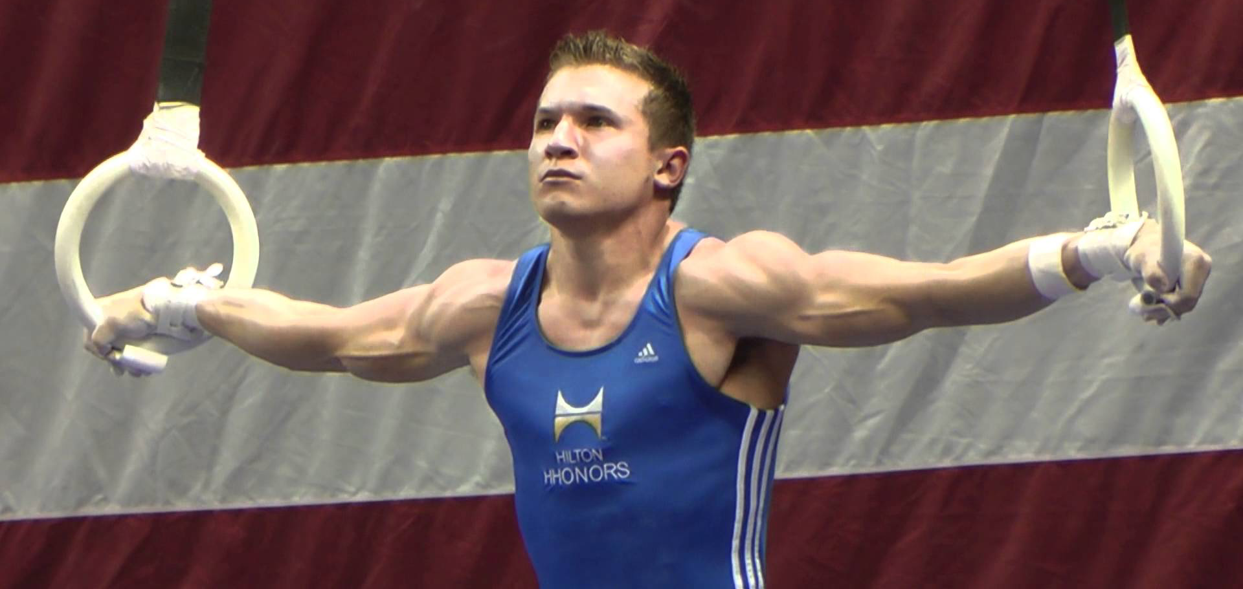
Example 10.2 Pulling a friend on a swing
Section 10.3: Decomposition of forces
Iron cross
x
x

Slide 32
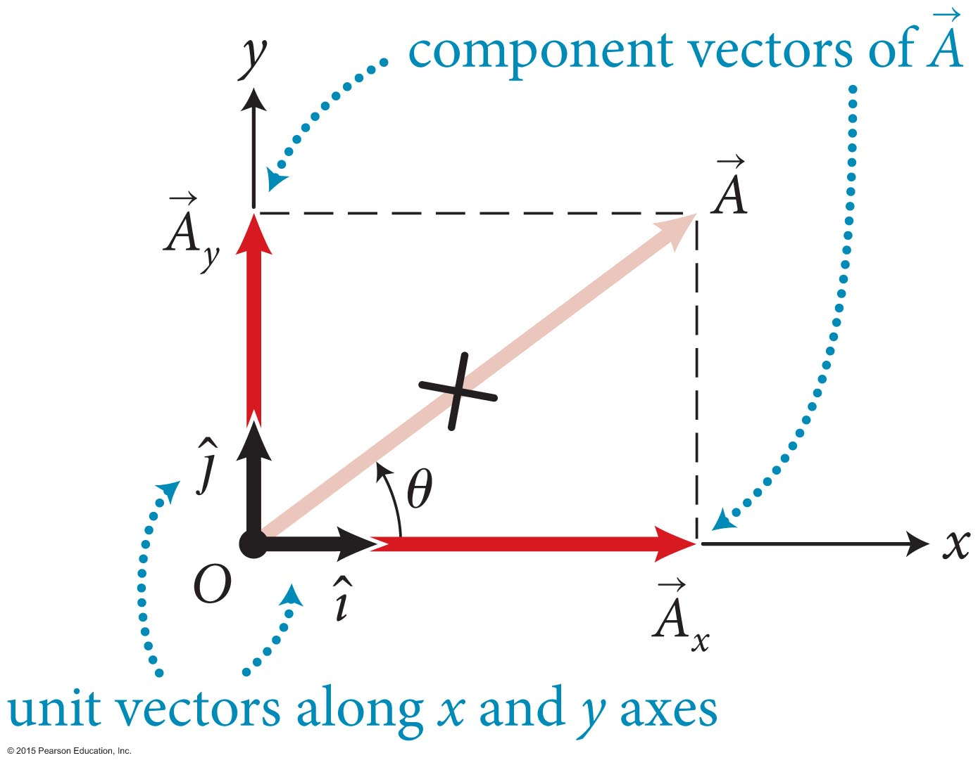
Section 10.6: Vector algebra
As illustrated in the figure, the decomposition of an arbitrary vector can be written as: where and represent unit vectors along x and y axes.
Using the Pythagorean theorem we can find the magnitude of as
The angle of with respect to the x axis is

Slide 33
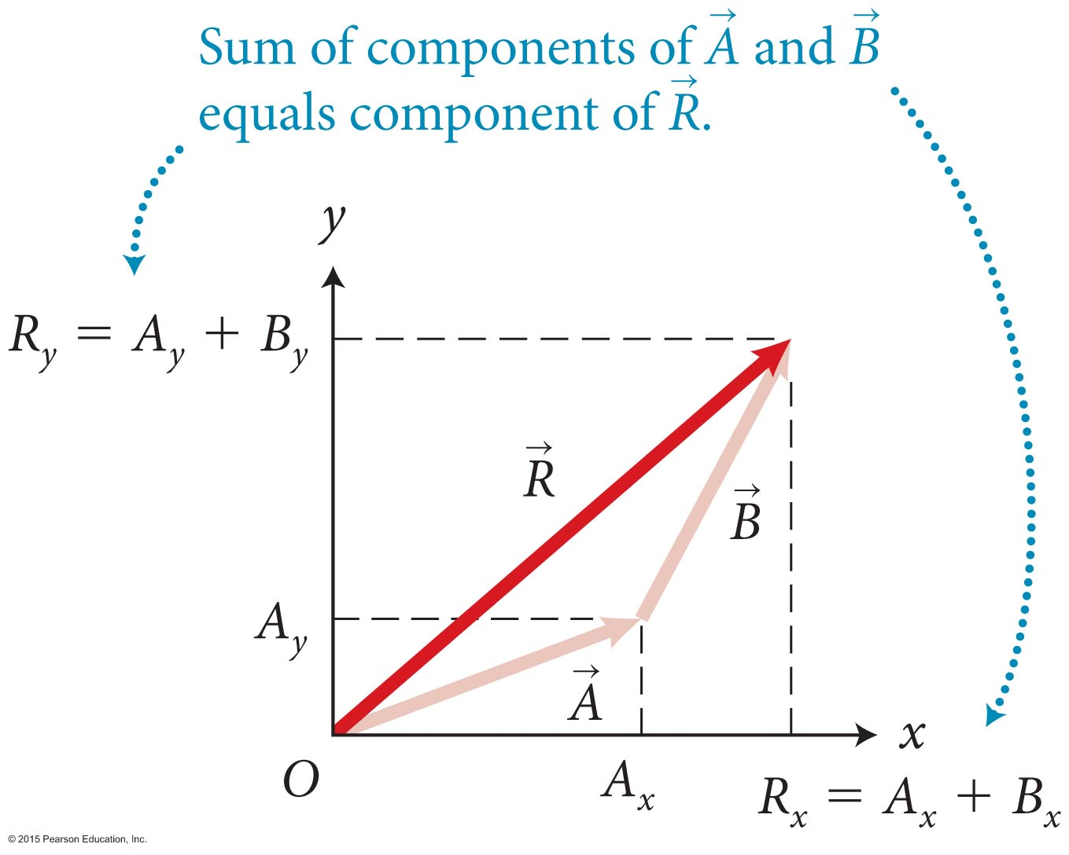
Section 10.6: Vector algebra
As illustrated in the figure, the decomposition of vectors is particularly useful when adding or subtracting them:
R_{x} = A_{x} + B_{x}
R_{y} = A_{y} + B_{y}

Slide 34
Section 10.7: Projectile motion in two
dimensions
The position vector of an object moving in two dimensions is
The object’s instantaneous velocity is so that,
Similarly, instantaneous acceleration components are
Decomposing vectors into components allows us to separate motion in a plane into two one-dimensional problems.

Slide 35
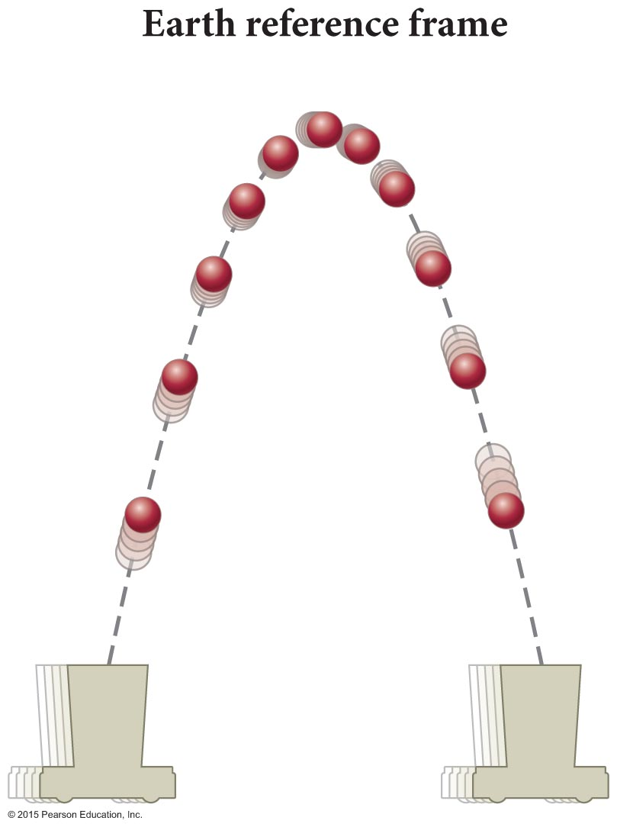
Section 10.7: Projectile motion in two
dimensions

Slide 36
Section 10.7: Projectile motion in two
dimensions
Consider the motion of a ball launched straight up from a cart moving at a constant velocity (see the figure on the previous slide).
The resulting two-dimensional projectile motion in Earth’s reference frame is the curved trajectory shown in the figure.
The balls has a constant downward acceleration of a_{y} = –g.
a_{y} = –g

Slide 37
Section 10.7: Projectile motion in two dimensions
In Earth’s reference frame, the ball’s initial velocity is
The ball’s launch angle relative to the x axis is
Using a_{x} = 0 and a_{y} = –g in Equations 3.4 and 3.8, υ_{x,f} = υ_{x,i} (constant velocity) υ_{y,f} = υ_{y,i} – gΔt (constant acceleration) x_{f} = x_{i} + υ_{x,i} Δt (constant velocity)
a_{y} = –g
y
x

Slide 38
Example 10.5 Position of highest point
Section 10.7: Projectile motion in dimensions
The ball is launched from the origin of an xy coordinate system. Write expressions giving the ball’s rectangular coordinates at the top of its trajectory, in terms of its initial speed υ_{i} and the acceleration due to gravity g.
x_{f} = x_{i} + υ_{x,i} Δt (constant velocity)
a_{y} = –g
Need to find time to get to the top:
Δt_{top}
y
x

Slide 39
Example 10.5 Position of highest point (cont.)
Section 10.7: Projectile motion in two dimensions
❶ Because the ball is launched from the origin, x_{i} = 0 and y_{i} = 0. As the ball passes through its highest position, υ_{y} reverses sign from positive to negative, so at the highest point υ_{y,f} = 0.
υ_{y,f} = υ_{y,i} – gΔt_{top} = 0
Solving for Δt_{top} then yields
a_{y} = –g
y
x

Slide 40
Example 10.5 Position of highest point (cont.)
Section 10.7: Projectile motion in two dimensions
❹ EVALUATE RESULT
Because the ball moves at constant velocity in the horizontal direction, the x coordinate of the highest position is the horizontal velocity component υ_{x,i} multiplied by the time interval it takes to reach the top.
The y coordinate of the highest position does not depend on υ_{x,i} because the vertical and horizontal motions are independent of each other.
a_{y} = –g
y
x

Slide 41
Example 10.6 Range of projectile
Section 10.7: Projectile motion in two dimensions
How far from the launch position is the position at which the ball is once again back in the cart? (This distance is called the horizontal range of the projectile.)
a_{y} = –g
y
x

Slide 42
Example 10.6 Range of projectile (cont.)
Section 10.7: Projectile motion in two dimensions
❸ Δt_{top} = υ_{y,i}/g. The time interval spent in the air is
Δt_{flight} = 2υ_{y,i}/g.
range
a_{y} = –g
range
0
without air friction
0 45 90

Slide 43
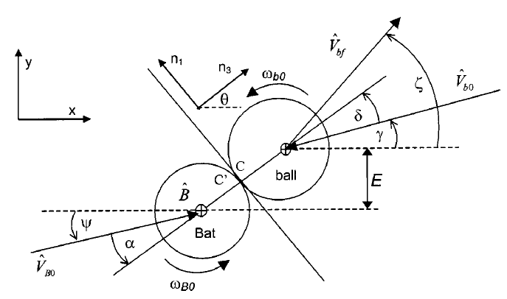
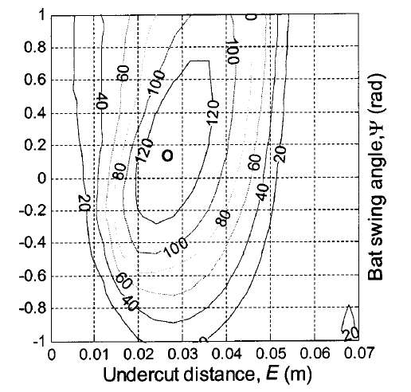
Example 10.6 Range of projectile (cont.)
Section 10.7: Projectile motion in two dimensions
ψ = 9º
E = 2.6 cm
optimal angle: 25º

Slide 44
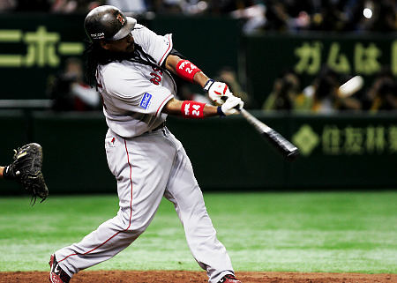
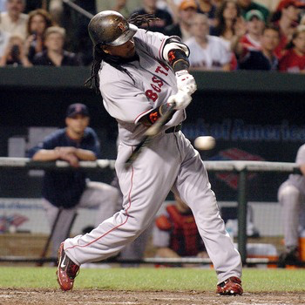
Example 10.6 Range of projectile (cont.)
Section 10.7: Projectile motion in two dimensions
https://www.youtube.com/watch?v=y9CEuJ5e2cM
Garciaparra
30sec – 1:30
https://www.youtube.com/watch?v=6VMVQbIq0V8
Ortiz
optimal angle: 25º
Manny Ramirez

Slide 45
Chapter 10 Motion in a Plane

Slide 46
Section 10.8: Collisions and momentum in two dimensions
Momentum conservation states that the momentum of an isolated system of colliding objects does not change, or
Momentum is a vector, so in two dimensions momentum change must be expressed in terms of the components.
Conservation of momentum in two dimensions is given by Δp_{x} = Δp_{1x} + Δp_{2x} = m₁(υ_{1x,f} – υ_{1x,i}) + m₂(υ_{2x,f} – υ_{2x,i}) = 0 Δp_{y} = Δp_{1y} + Δp_{2y} = m₁(υ_{1y,f} – υ_{1y,i}) + m₂(υ_{2y,f} – υ_{2y,i}) = 0.

Slide 47
Section 10.4: Friction
Consider the contact force exerted by the floor on the cabinet:
The normal component is called the normal force and the tangential component is the force of friction.
To understand the difference between normal and frictional forces, consider the brick on a horizontal wooden plank.
As seen in the figure, the normal force takes on whatever value to balance the net downward force, up to the breaking point.

Slide 48
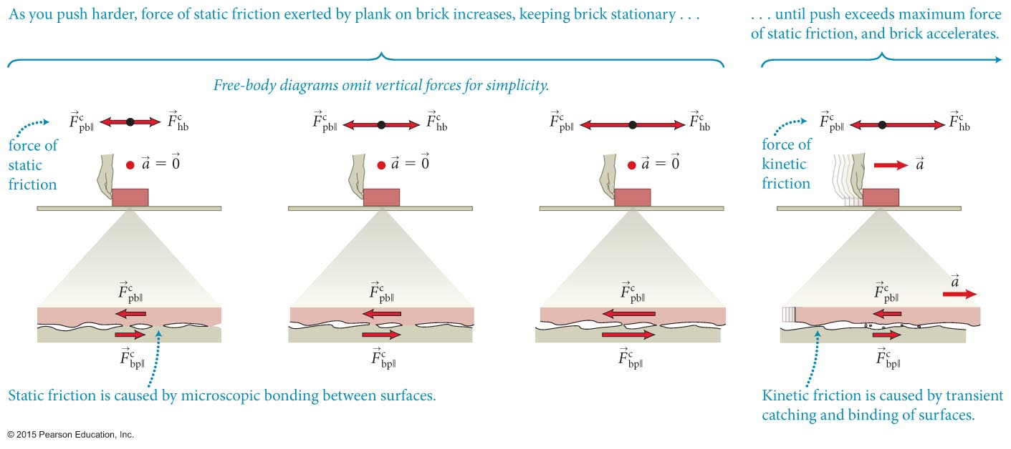
Section 10.4: Friction
Now consider gently pushing the brick to the right, as shown.
The horizontal frictional force is caused by microscopic bonds between the surfaces in contact.
As you push the brick, the net effect of these microscopic forces is to hold the brick in place.
As you increase your push force, this tangential component of the contact force grows.

Slide 49
Section 10.4: Friction
The friction exerted by the surfaces that are not moving relative to each other is called static friction.
When the horizontal push force exceeds the maximum force of static friction, the brick will accelerate.
The friction force exerted by the surfaces when they move relative to each other is call kinetic friction, which is caused by transient microscopic bonds between the two surfaces.

Slide 50
Section 10.4
Clicker Question 3
You push horizontally on a crate at rest on the floor, gently at first and then with increasing force until you cannot push harder. The crate does not move. What happens to the force of static friction between crate and floor during this process?
It is always zero.
It remains constant in magnitude.
It increases in magnitude.
It decreases in magnitude.
More information is needed to decide.

Slide 51
Section 10.4
Clicker Question 3
You push horizontally on a crate at rest on the floor, gently at first and then with increasing force until you cannot push harder. The crate does not move. What happens to the force of static friction between crate and floor during this process?
It is always zero.
It remains constant in magnitude.
It increases in magnitude.
It decreases in magnitude.
More information is needed to decide.

Slide 52
Section 10.5: Work and Friction
Like normal force, the force of static friction is an elastic force that causes no irreversible change.
The force of static friction causes no energy dissipation.
Kinetic friction does cause irreversible change, including causing microscopic damage to the surfaces.
The force of kinetic friction is not an elastic force and so causes energy dissipation.

Slide 53
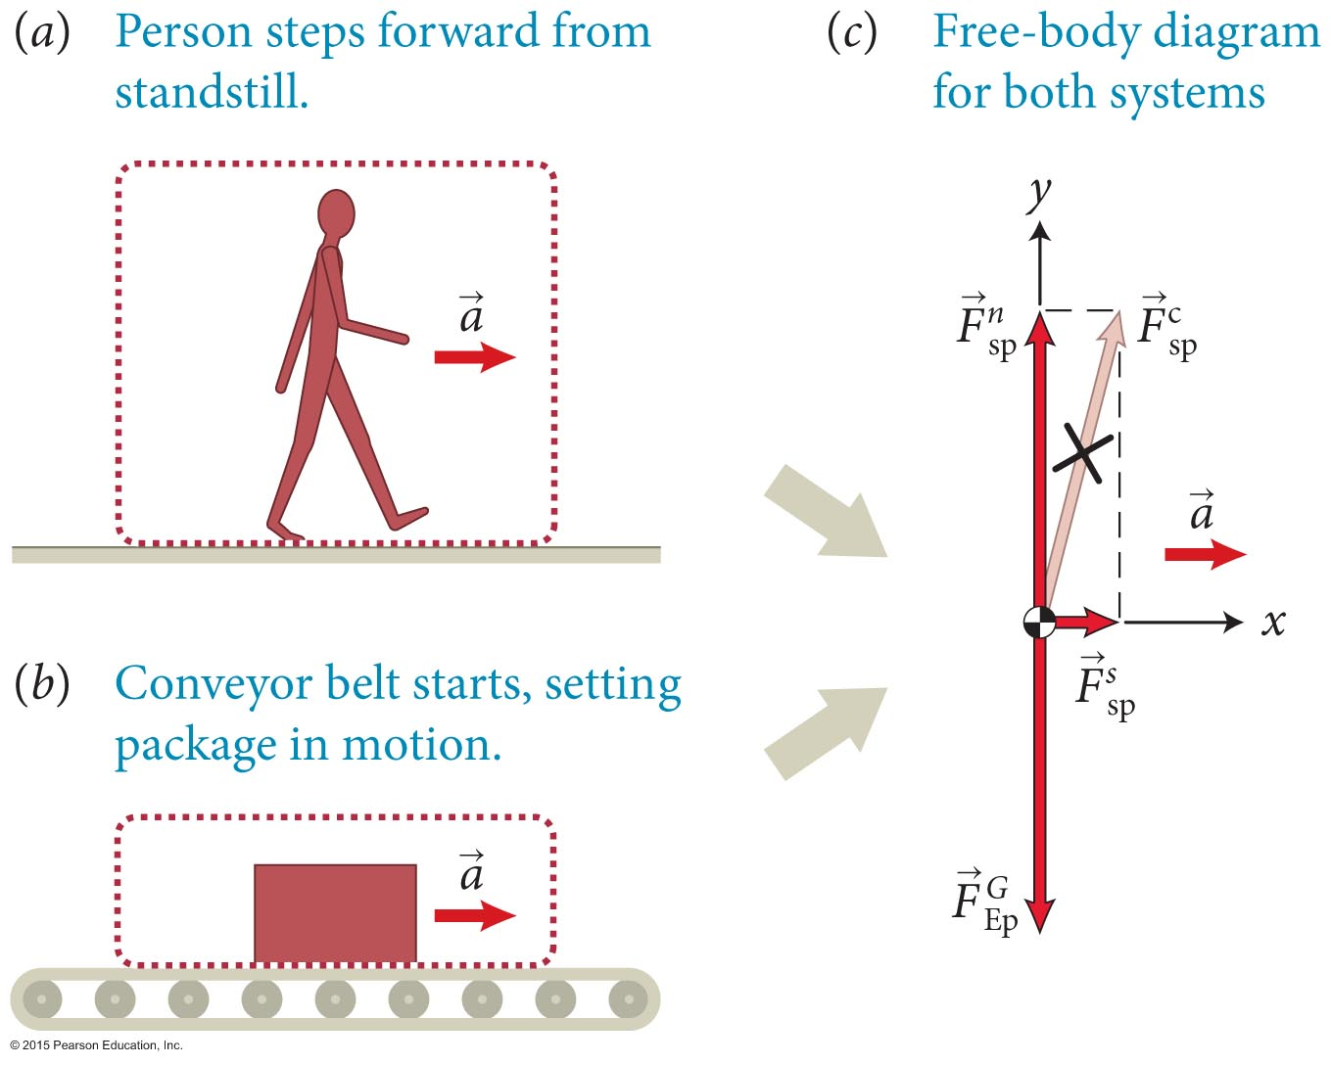
Section 10.5: Work and Friction
Two examples where the object is accelerated by static friction.

Slide 54
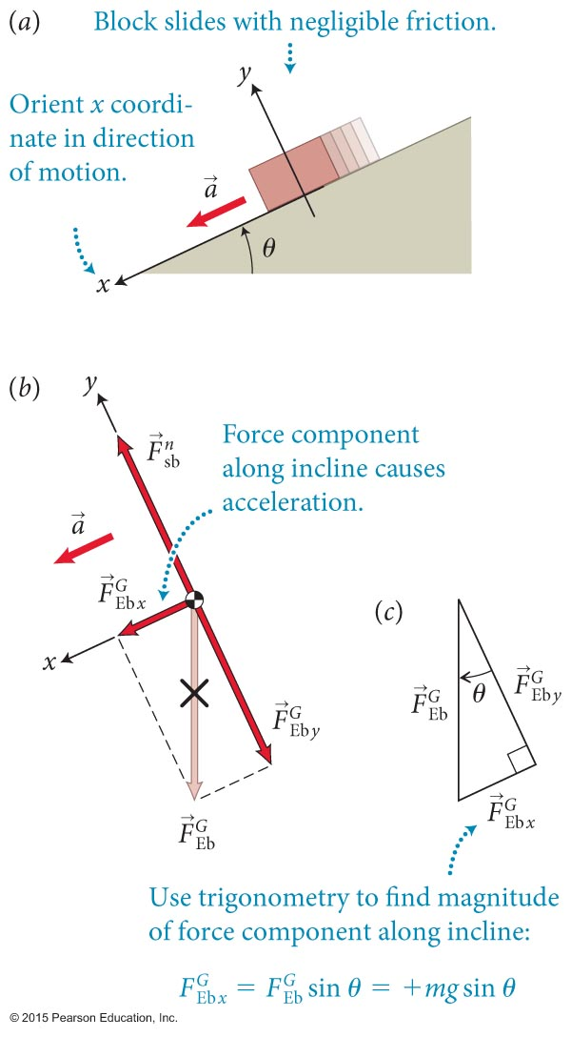
Section 10.9: Work as the product of two vectors
Consider a block sliding down an incline as shown (ignore friction).
The x component of the force of gravity is what causes the block to accelerate
The magnitude of the resulting acceleration is

Slide 55
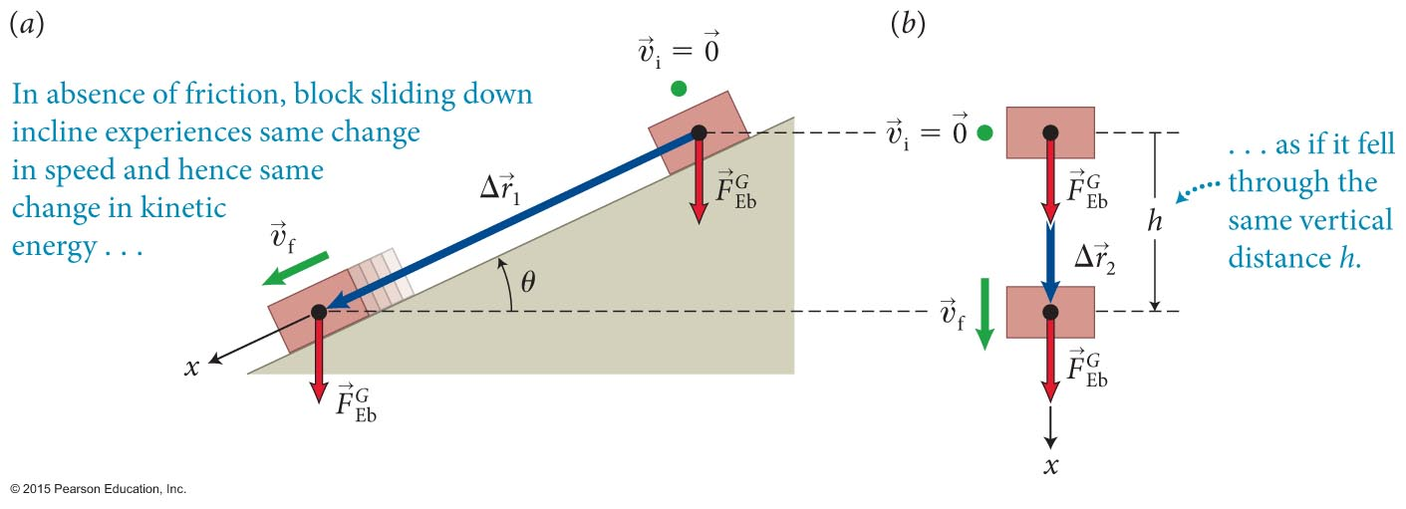
Section 10.9: Work as the product of two vectors
As illustrated in the figure, the block begins at rest (υ_{x,i} = 0) at position x_{i} = 0 and drops a height h.
The displacement along the incline is Δx = +h/sinθ.
The time the block takes to cover this distance is obtained from Equation 3.7: from which we obtain

Slide 56
Section 10.9: Work as the product of two vectors
Using Equation 3.4 and Equation 10.25, the blocks final kinetic energy is then
Substituting Equation 10.28 into Equation 10.29, we obtain
Because the blocks initial kinetic energy is zero, we get
We can get the same result by using the work equation:

Slide 57
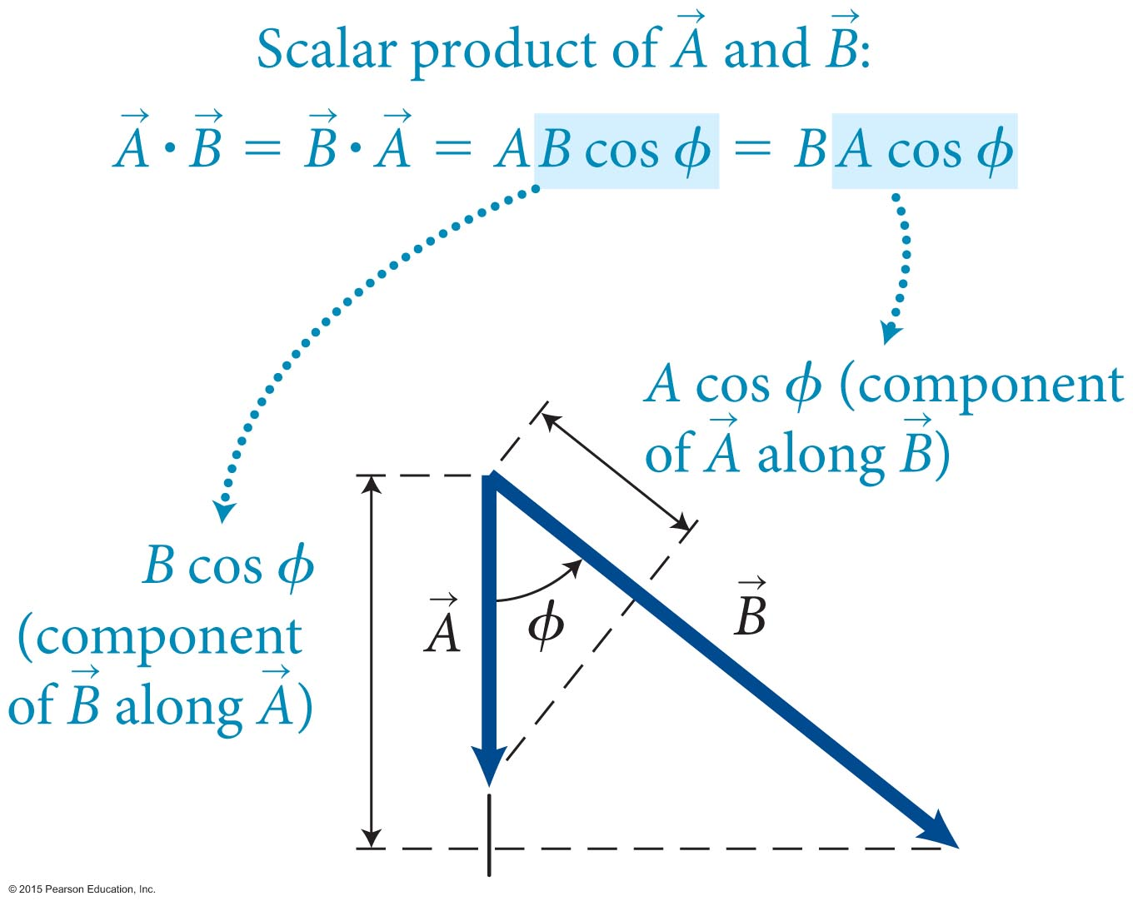
Section 10.9: Work as the product of two vectors
If the angle between and is ϕ, the scalar product of the two vectors is
The scalar product is commutative:

Slide 58
Section 10.9
Clicker Question 8
Under what circumstances could the scalar product of two vectors be zero?
When the vectors are parallel to each other
When the vectors are perpendicular to each other
When the vectors make an acute angle with each other
None of the above

Slide 59
Section 10.9
Clicker Question 8
Under what circumstances could the scalar product of two vectors be zero?
When the vectors are parallel to each other
When the vectors are perpendicular to each other
When the vectors make an acute angle with each other
None of the above

Slide 60
Section 10.9: Work as the product of two vectors
We can write work as a scalar product:
The normal force does no work, because ϕ = 90° between the normal force and the force displacement.
The work done by gravity on the block is where θ is the angle of the incline.
However, since ϕ = π/2 – θ, we have W = mgh.
If force and force displacement are opposite (ϕ = 180°), then work is negative.
φ
h

Slide 61
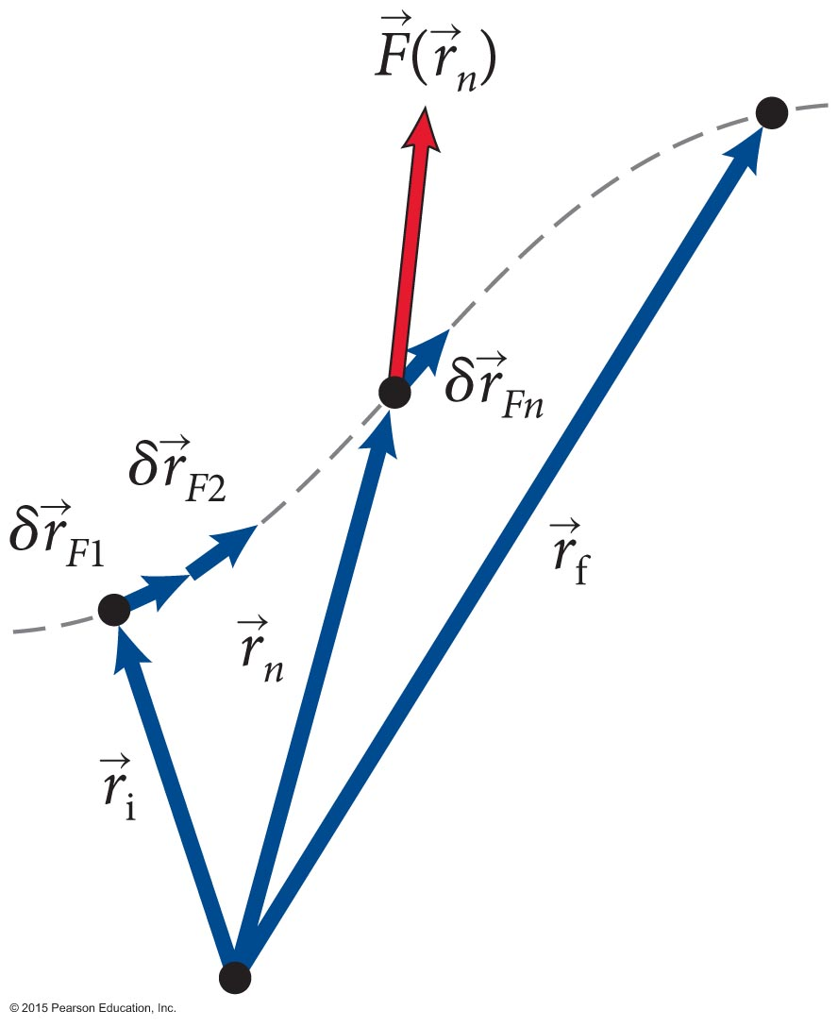
Section 10.9: Work as the product of two vectors
Let us generalize the previous result to forces that are not constant,
Start by subdividing the force displacement into many small fragments Work done by a variable force over a small displacement is
The work done over the entire force displacement is:

Slide 62
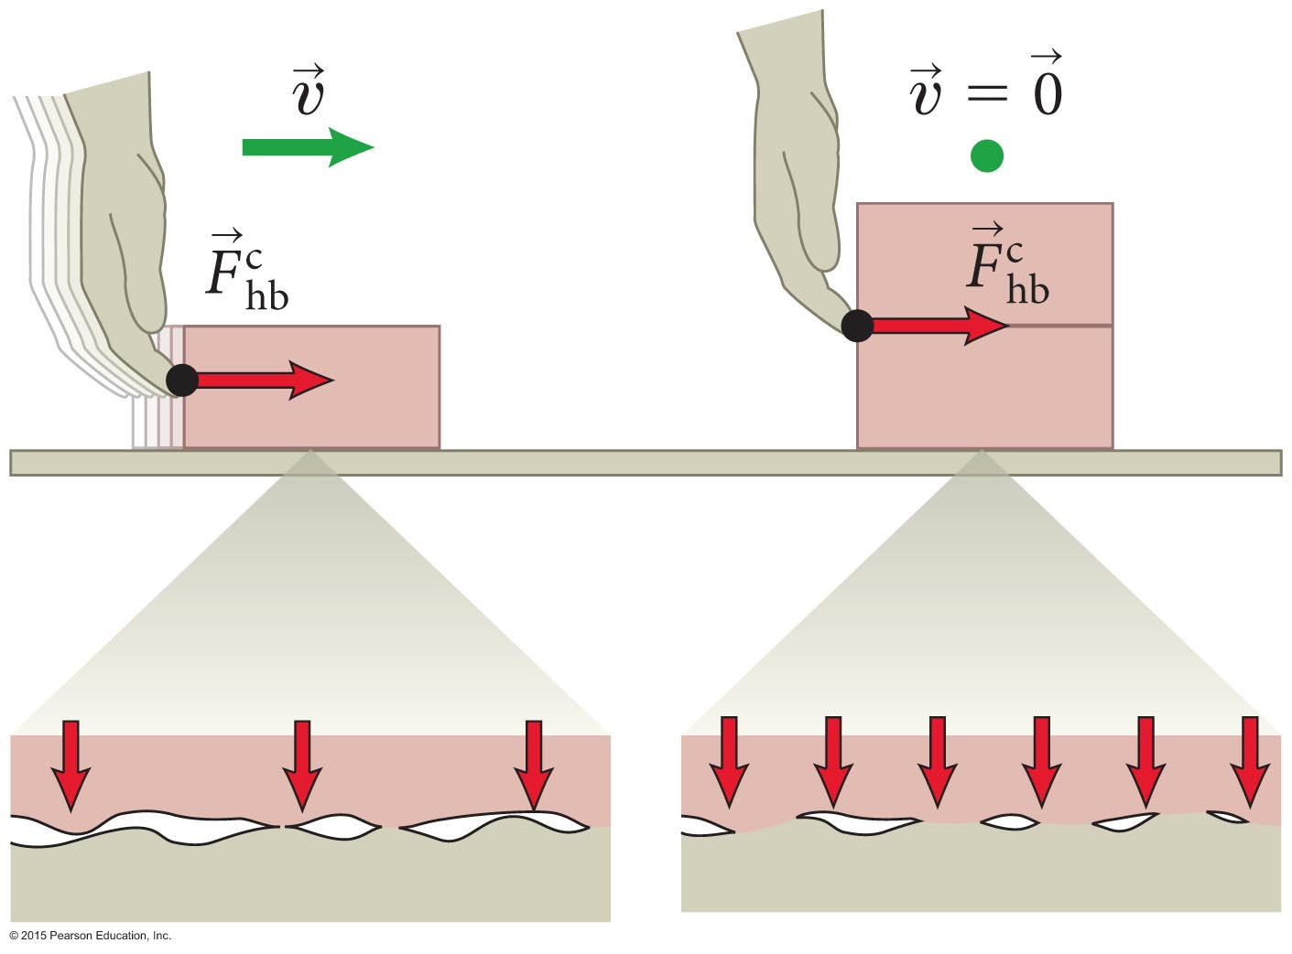
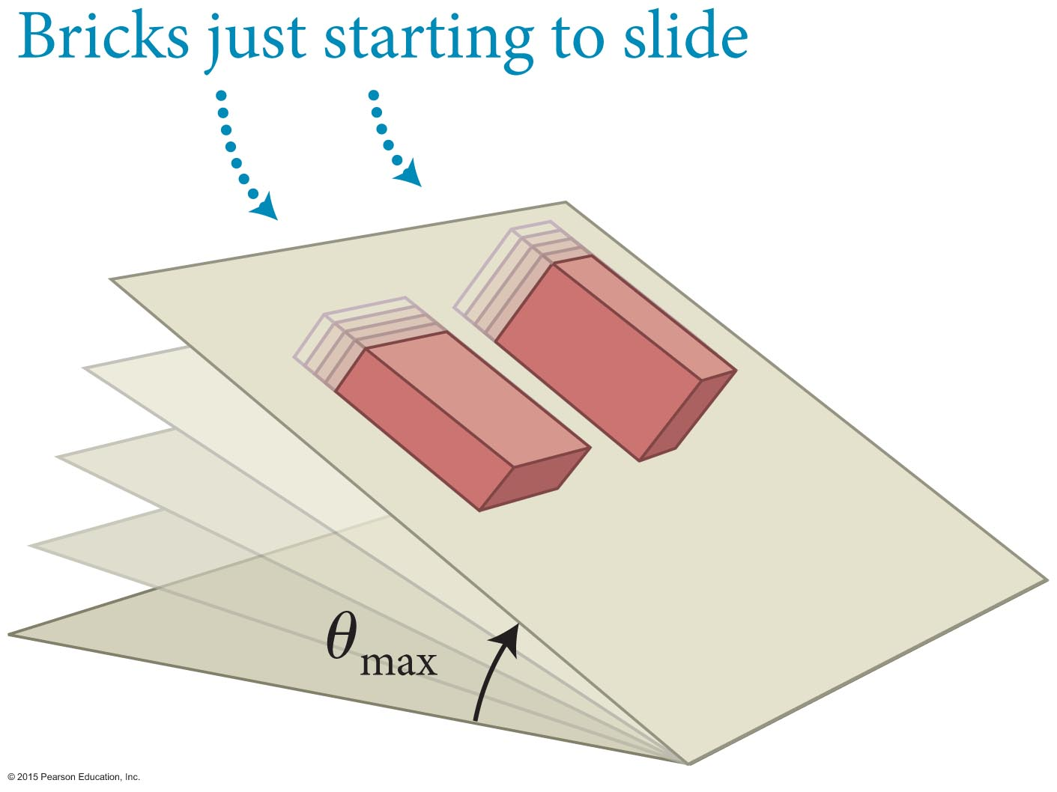
Section 10.10: Coefficients of Friction
Let us now develop a quantitative description of friction:
The figure illustrates the following observations.
The maximum force of static friction exerted by a surface on an object is proportional to the force with which the object presses the surface.
The force of static friction does not depend on the contact area.

Slide 63
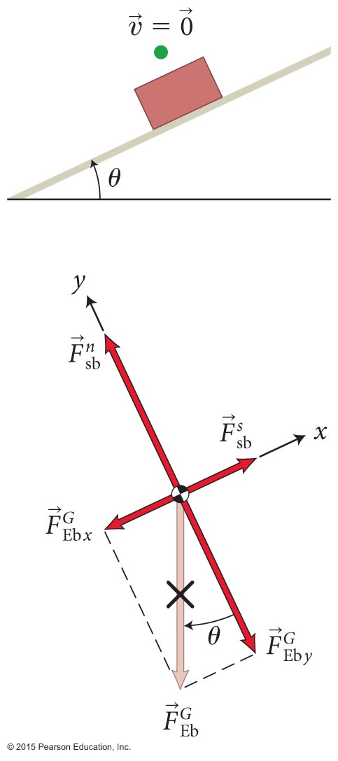
Section 10.10: Coefficients of Friction
As we have just determined, the maximum magnitude of the static friction force must be proportional to as seen in the figure.
Therefore, for any two surfaces 1 and 2 we have
The unitless proportionality constant μ_{s} is called the coefficient of static friction.
This upper limit means that the magnitude of static friction must obey the following condition:

Slide 64
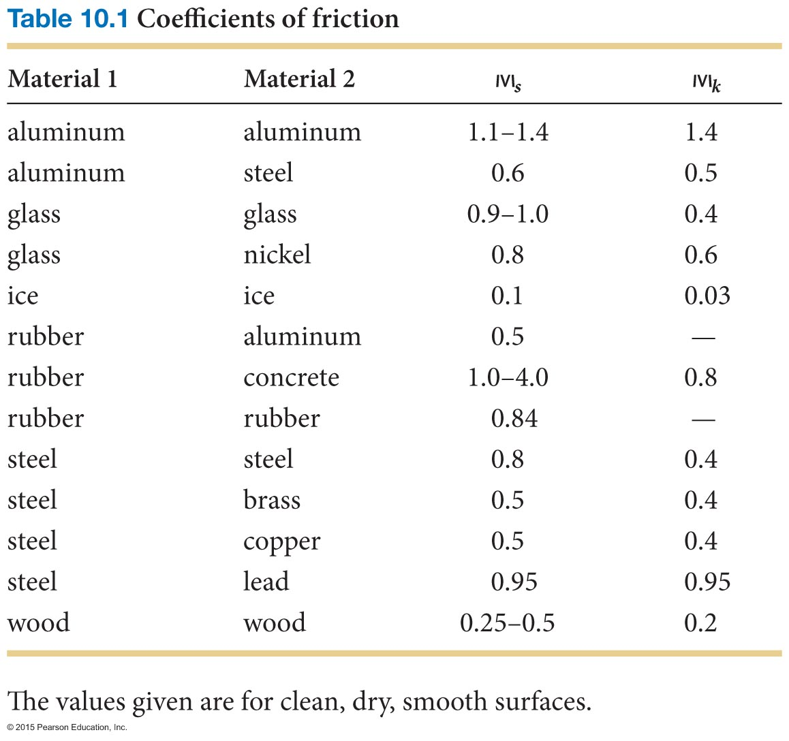
Section 10.10: Coefficients of Friction

Slide 65
Section 10.10
Clicker Question 9
In a panic situation, many drivers make the mistake of locking their brakes and skidding to a stop rather than applying the brakes gently. A skidding car often takes longer to stop. Why?
This is a misconception; it doesn’t matter how the brakes are applied.
The coefficient of static friction is larger than the coefficient of kinetic friction.
The coefficient of kinetic friction is larger than the coefficient of static friction.

Slide 66
Section 10.10
Clicker Question 9
In a panic situation, many drivers make the mistake of locking their brakes and skidding to a stop rather than applying the brakes gently. A skidding car often takes longer to stop. Why?
This is a misconception; it doesn’t matter how the brakes are applied.
The coefficient of static friction is larger than the coefficient of kinetic friction.
The coefficient of kinetic friction is larger than the coefficient of static friction.

Slide 67
Example 10.8 Pulling a friend up a hill
Section 10.10: Coefficients of Friction
A hiker is helping a friend up a hill that makes an angle of 30° with level ground. The hiker, who is farther up the hill, is pulling on a cable attached to his friend. The cable is parallel to the hill so that it also makes an angle of 30° with the horizontal. If the coefficient of static friction between the soles of the hiker’s boots and the surface of the hill is 0.80 and his inertia is 65 kg, what is the maximum magnitude of the force he can exert on the cable without slipping?

Slide 68
Example 10.8 Pulling a friend up a hill (cont.)
Section 10.10: Coefficients of Friction
❶ GETTING STARTED The forces exerted on the hiker are a force exerted by the cable and directed down the hill (this force forms an interaction pair with the force the hiker exerts on the cable), the force of gravity , and the contact force exerted by the surface of the hill on the hiker.

Slide 69
Example 10.8 Pulling a friend up a hill (cont.)
Section 10.10: Coefficients of Friction
❶ GETTING STARTED This last force has two components: the normal force and the force of static friction . The force of static friction is directed up the hill. If the hiker is not to slip, his acceleration must be zero, and so the forces in the normal (y) and tangential (x) directions must add up to zero.

Slide 70
Example 10.8 Pulling a friend up a hill (cont.)
Section 10.10: Coefficients of Friction
❸ Because the magnitude of the force of gravity exerted on the hiker is mg, I have in the y direction
where the minus sign in –mg cos θ indicates that is in the negative y direction.

Slide 71
Example 10.8 Pulling a friend up a hill (cont.)
Section 10.10: Coefficients of Friction
❸ Likewise, I have in the x direction

Slide 72
Example 10.8 Pulling a friend up a hill (cont.)
Section 10.10: Coefficients of Friction
❸ EXECUTE PLAN If the hiker is not to slip, the force of static friction must not exceed its maximum value. Substituting Eqs. 1 and 2 into Inequality 10.54, I get

Slide 73
Example 10.8 Pulling a friend up a hill (cont.)
Section 10.10: Coefficients of Friction
❸ EXECUTE PLAN The problem asks me about the magnitude of the force exerted by the hiker on the cable, which is the same as the magnitude of the force exerted by the cable on the hiker, so

Slide 74
Example 10.8 Pulling a friend up a hill (cont.)
Section 10.10: Coefficients of Friction
❸ Substituting the values given,

Slide 75
Example 10.8 Pulling a friend up a hill (cont.)
Section 10.10: Coefficients of Friction
❹ EVALUATE RESULT A force of 1.2 × 10² N corresponds to the gravitational force exerted by Earth on an object that has an inertia of only 12 kg, and so the hiker cannot pull very hard before slipping. I know from experience, however, that unless I can lock a foot behind some solid object, it is impossible to pull hard on an inclined surface, and thus the answer I obtained makes sense.

Slide 76
Chapter 10 Motion in a Plane

Slide 77
Section 10.10: Coefficients of Friction
Once surfaces start to slip relative to each other, the force of kinetic friction is relative to the normal force where μ_{k} is called the coefficient of kinetic friction.
The kinetic coefficient μ_{k} is always smaller then μ_{s}.

Slide 78
Concepts: Vectors in two dimensions
Chapter 10: Summary
To add two vectors and , place the tail of at the head of .Their sum is the vector drawn from tail of to the head of .
To subtract from , reverse the direction of and then add the reversed to .
Any vector can be written as where A_{x} and A_{y} are the components of along the x and y axes.

Slide 79
Quantitative Tools: Vectors in two dimensions
Chapter 10: Summary
The magnitude of any vector is and the angle θ that makes with the positive x axis is given by
If is the vector sum of and , the component of are
The scalar product of two vectors and that make an angle ϕ when placed tail to tail is

Slide 80
Concepts: Projectile motion in two dimensions
Chapter 10: Summary
For a projectile that moves near Earth’s surface and experiences only the force of gravity, the acceleration has a magnitude g and is directed downward.
The projectile’s horizontal acceleration is zero, and the horizontal component of its velocity remains constant.
At the highest point in the trajectory of a projectile, the vertical velocity component υ_{y} is zero, but the vertical component of the acceleration is g and is directed downward.

Slide 81
Quantitative Tools: Projectile motion in two dimensions
Chapter 10: Summary
If a projectile is at a position (x, y), its position vector is
If a projectile has position components x_{i} and y_{i} and velocity components υ_{x,i} and υ_{y,i} at one instant, then its acceleration, velocity, and position components a time interval Δt later are

Slide 82
Concepts: Collisions and momentum in two dimensions
Chapter 10: Summary
Momentum is a vector, so in two dimensions its changes in momentum must be accounted for by components.
This means two equations, one for the x component and one for the y component of momentum.
The coefficient of restitution is a scalar and is accounted for by a single equation.

Slide 83
Quantitative Tools: Collisions and momentum in two dimensions
Chapter 10: Summary
Δp_{x} =Δp_{1x} + Δp_{2x} = m₁(υ_{1x,f} – υ_{1x,i}) + m₂(υ_{2x,f} – υ_{2x,i}) = 0
Δp_{y} =Δp_{1y} + Δp_{2y} = m₁(υ_{1y,f} – υ_{1y,i}) + m₂(υ_{2y,f} – υ_{2y,i}) = 0

Slide 84
Concepts: Forces in two dimensions
Chapter 10: Summary
In two-dimensional motion, the component of the acceleration parallel to the instantaneous velocity changes the speed and the component of the acceleration perpendicular to the instantaneous velocity changes the direction of the instantaneous velocity.
When choosing a coordinate system for a problem dealing with an accelerating object, if possible make one of the axes lie along the direction of the acceleration.

Slide 85
Concepts: Friction
Chapter 10: Summary
When two surfaces touch each other, the component of the contact force perpendicular (normal) to the surfaces is called the normal force and the component parallel (tangential) to the surfaces is called the force of friction.
The direction of the force of friction is such that the force opposes relative motion between the two surfaces. When the surfaces are not moving relative to each other, we have static friction.

Slide 86
Concepts: Friction
Chapter 10: Summary
When the forces are moving relative to each other, we have kinetic friction.
The magnitude of the force of kinetic friction is independent of the contact area and independent of the relative speeds of the two surfaces.

Slide 87
Quantitative Tools: Friction
Chapter 10: Summary
The maximum magnitude of the force of static friction between any two surfaces 1 and 2 is proportional to the normal face: where μ_{s} is the unitless coefficient of static friction. This upper limit means that the magnitude of the frictional force must obey the condition
The magnitude of the force of kinetic friction is also proportional to the normal face: where μ_{k} ≤ μ_{s} is the unitless coefficient of kinetic friction.

Slide 88
Concepts: Work
Chapter 10: Summary
For a sliding object, the normal force does no work because this force is perpendicular to the direction of the object’s displacement.
The force of kinetic friction is a nonelastic force and thus causes energy dissipation.
The force of static friction is an elastic force and so causes no energy dissipation.
The work done by gravity is independent of path.

Slide 89
Quantitative Tools: Work
Chapter 10: Summary
The work done by a constant nondissipative force when the point of application of the force undergoes a displacement is
The work done by a variable nondissipative force when the point of application of the force undergoes a displacement is
This is the line integral of the force over the path traced out by the point of application of the force.

Slide 90
Quantitative Tools: Work
Chapter 10: Summary
For a variable dissipative force, the change in the thermal energy is
When an object descends a vertical distance h, no matter what path it follows, the work gravity does on it is
W = mgh.

